Slide 1

Machine Learning
Course winter 2025
Hubei Polytechnic University
Instructor: Dr. Waqas Ahmed

Slide 2
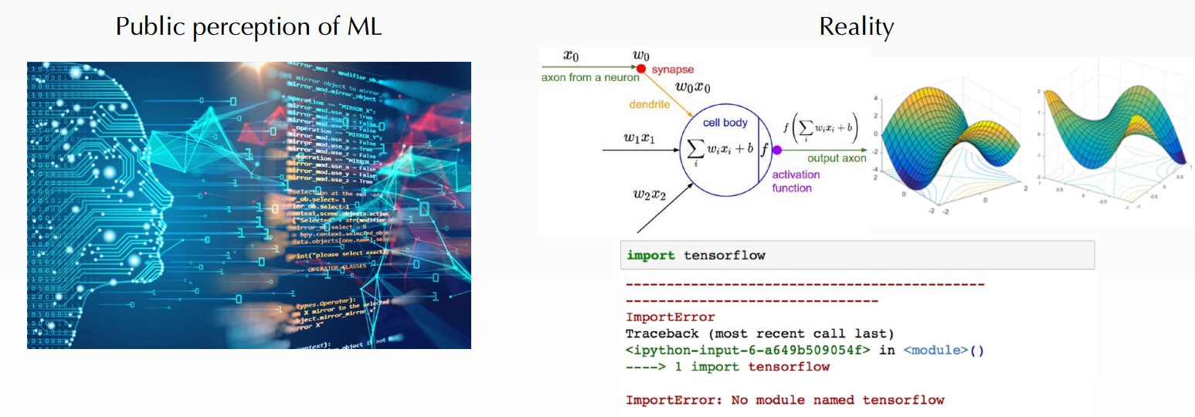
What do you learn from this course? 你从这门课程中学到了什么？
Concepts, tools, and intuition you need to implement programs capable of learning from data 实现能够从数据中学习的程序所需的概念、工具和直觉
From simple techniques such as linear regression to some of deep learning techniques 从简单的技术（例如线性回归）到部分深度学习技术
A hands-on approach with just a little bit of theory to use production-ready Python frameworks 通过以实践为主、少量理论结合的方式，学习如何使用可投入生产的 Python 框架

Slide 3
Course prerequisites 课程先修要求
We need some level of calculus and linear algebra 我们需要具备一定程度的微积分和线性代数知识
Vector, matrix, inner product, matrix-matrix multiplication 向量、矩阵、内积、矩阵与矩阵的乘法
Derivatives of polynomials and exponential functions 多项式函数和指数函数的导数
• Chain rule for finding the derivative of a composite function 利用链式法则求复合函数的导数
• Basics of probability and statistics 概率与统计的基础知识
• Probability distributions (normal distribution, Bernoulli distribution, etc.) 概率分布（如正态分布、伯努利分布等）
• Mean, standard deviation, … 均值、标准差等基本统计量

Slide 4
Basic concept
1950 first time introduced a concept of Artificial Intelligence.
— 1950年，首次提出了人工智能的概念。
What is the goal of this concept?
— 这个概念的目标是什么？ Our goal is for machines to become intelligent like humans. Just like the human mind, they look at situations and make decisions.
— 我们的目标是让机器像人类一样具有智能。 就像人类的大脑一样，它们能够观察情况并作出决策。

Slide 5
Artifical intelegence is technique not a subject.We Join different subject like mathematics, Statistic , programing etc to made a unique technique 人工智能是技术而不是学科。我们加入不同的学科，如数学、统计学、编程等，以创造一种独特的技术
Artifical Intelegence
Machine Learning
Deep Learning

Slide 6
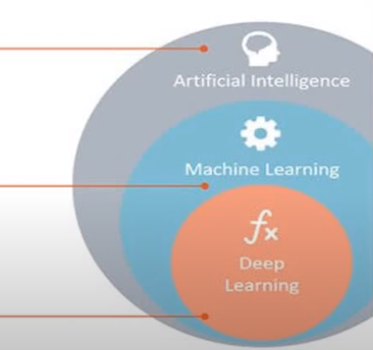
Defination of these terms
Artificial Intelligence: Any techniques which enable computers to mimic human behaviour. — 人工智能： 任何能够使计算机模仿人类行为的技术。
Machine Learning: Subset of AI techniques which use statistical methods to enable machines to improve with experience
. — 机器学习： 人工智能技术的一个子集，使用统计方法使机器能够通过经验不断改进。
Deep Learning: Subset of ML which makes the computation of multi-layer neural networks feasible.
— 深度学习： 机器学习的一个子集，使多层神经网络的计算成为可能

Slide 7
Data Preprocessing:
Pre-Processing refers to the transformation applied to our data before feeding it to algorithm 预处理是指在将数据输入算法之前，对数据进行的转换。
Data preprocessing is a technique that is used to convert the raw data into a clean data set. 数据预处理是一种将原始数据转换为干净数据集的技术。
Data is gathered from different sources in raw format which is not feasible for the analytics. 数据来自不同来源的原始格式，这种格式不适合进行分析。
We use the following three libraries of Python for this: 我们为此使用以下三个 Python 库：
Numpy
Matplotlib
Pandas

Slide 8
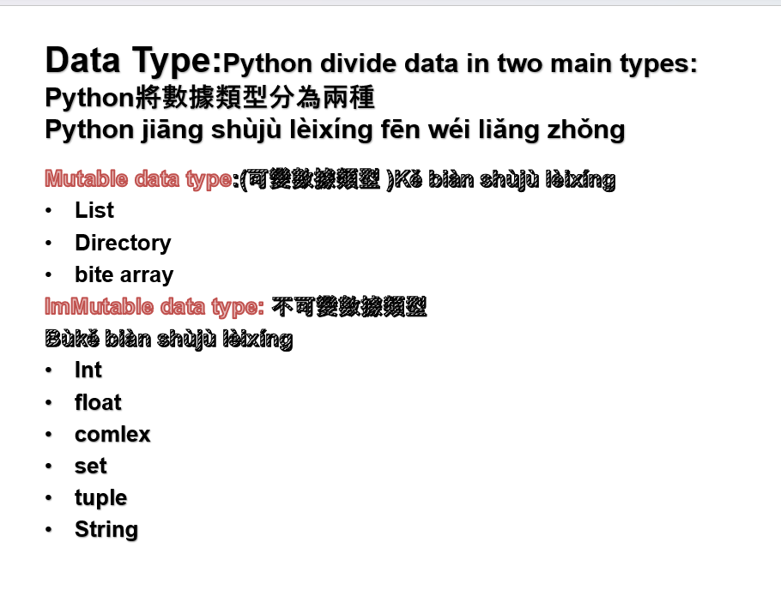

Slide 9
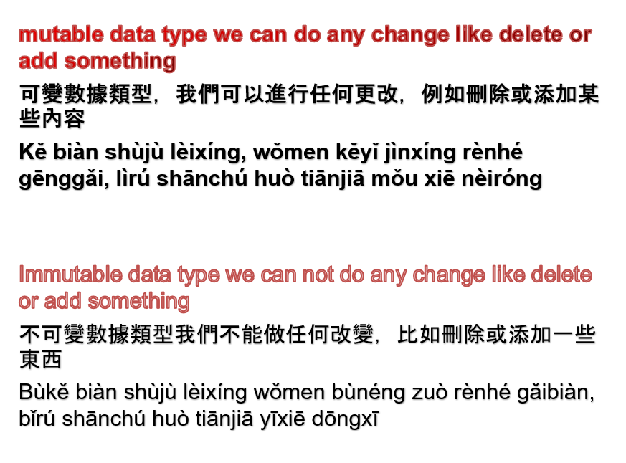

Slide 10
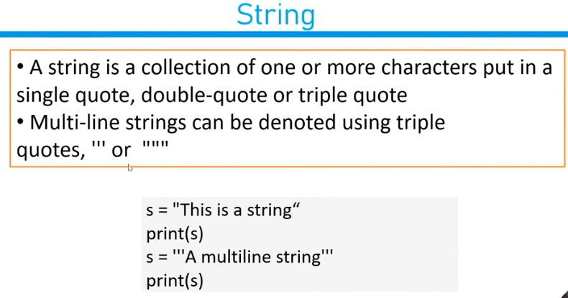

Slide 11
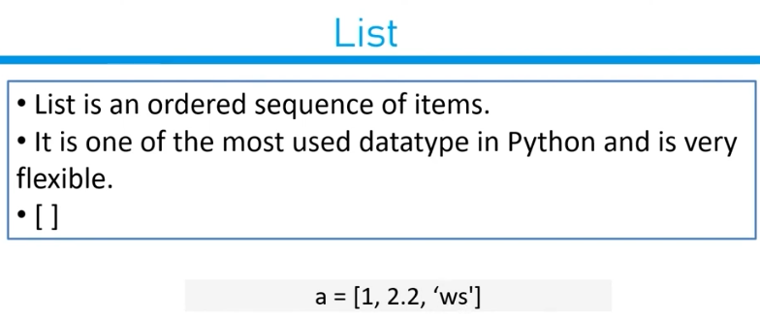

Slide 12
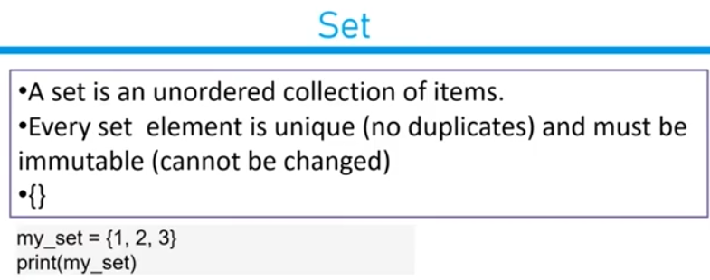

Slide 13
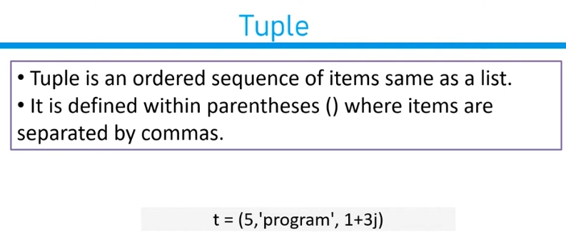

Slide 14
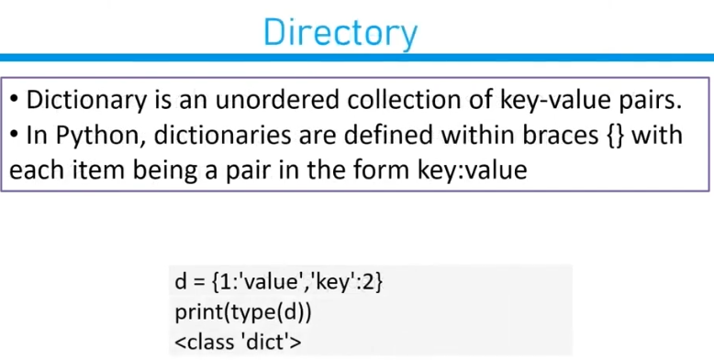

Slide 15
Practical Tutorial: see git hub
https://github.com/WaqasAhmedmit/Machine-Learning-Lectures-Winter-2025./upload/main

